Slide 1
APUSH Review: The Election of 1860
Period 5: 1844 – 1877
Everything You Need To Know About The Election Of 1860 To Succeed In APUSH

Slide 2
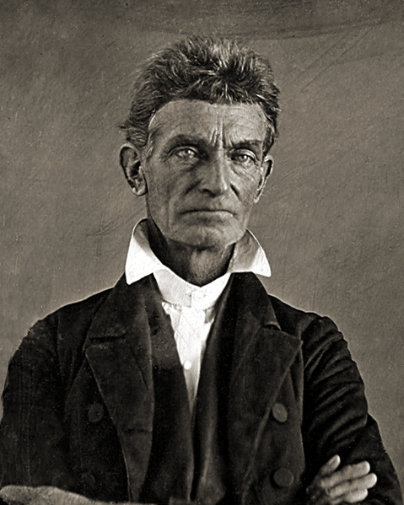
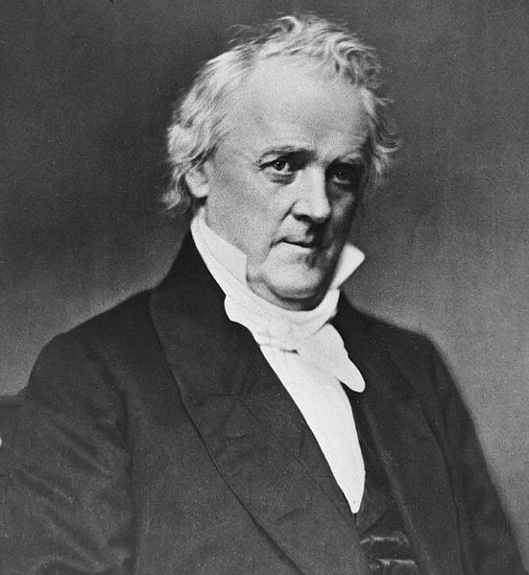
Background Info
James Buchanan (incumbent) is NOT running for re-election
Democratic Party was split along sectional lines – Douglass’ “Freeport Doctrine”
John Brown’s raid at Harpers Ferry took place one year before
The South fears Republicans and the North are “John Brown loving abolitionists”

Slide 3
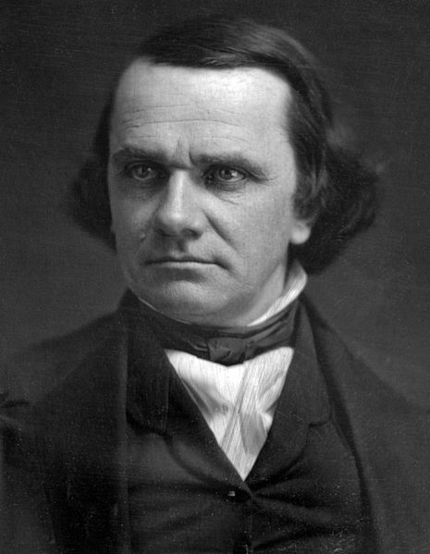
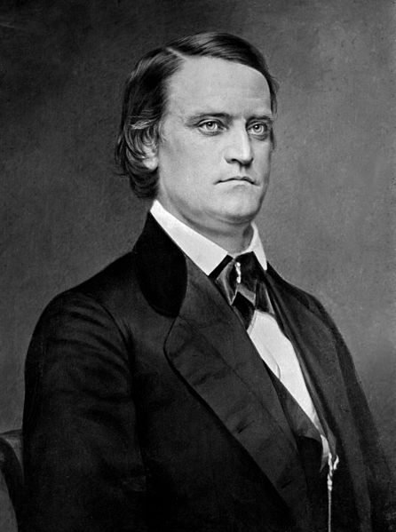
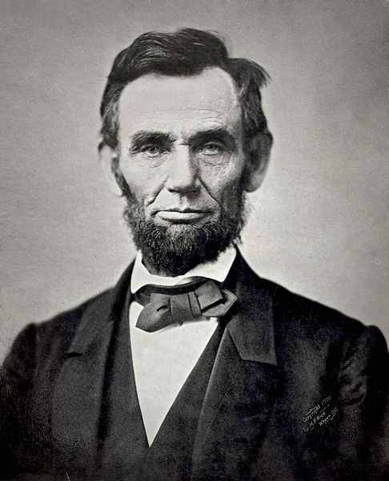
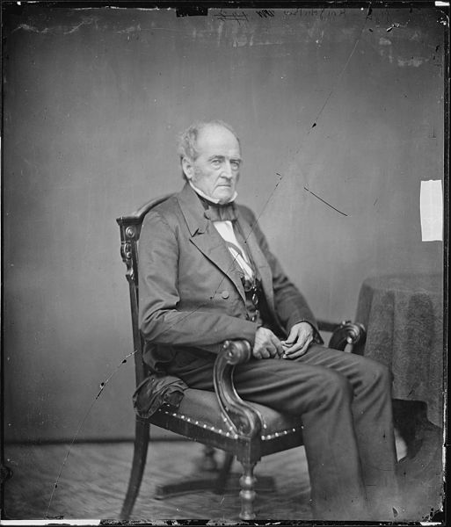
The Candidates
Democratic Candidate:
North – Stephen Douglass – advocate of popular sovereignty
South – John C. Breckenridge – Buchanan’s VP
Republican Candidate:
Abe Lincoln – free-soil platform – non-extension of slavery
Constitutional Union Party:
John Bell – hoped to preserve the union

Slide 4
The Issues
Slavery:
Compromise of 1850, the KS-NB Act, and Dred Scott failed to reduce sectional tensions
Many “fire-eater” southerners threatened secession if Lincoln won…..

Slide 5
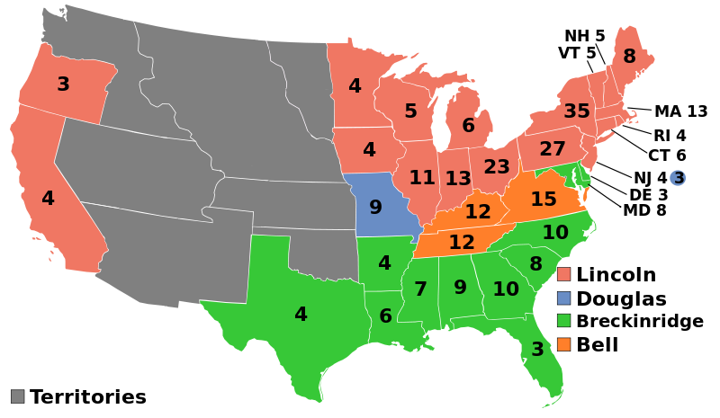
The Results
Electoral results: 152 needed to win
Douglass – 12
Bell – 39
Breckenridge – 72
Lincoln – 180
Lincoln wins election without carrying a single Southern state!

Slide 6
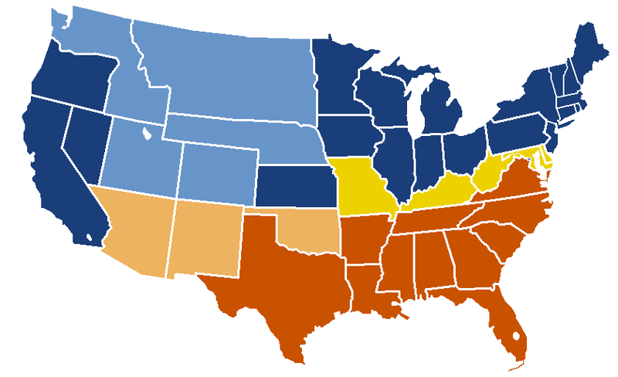
Impact
Immediate cause of the Civil War
Southern states begin to secede before Lincoln’s inauguration on March 4, 1861
SC (12/20/1860)
MS (1/9/1861)
FL (1/10/1861)
AL (1/11/1861)
GA (1/19/1861)
LA (2/1/1861)
Buchanan did NOTHING to stop the secession!
More secede after the war starts on 4/12/1861
VA (4/17/1861)
AR (5/6/1861)
TN (5/7/1861)
NC (5/20/1861)

Slide 7
Test Tips
Multiple-Choice and Short Answer Questions:
Lincoln’s platform was for the NON-EXTENSION of slavery
Immediate cause secession and Civil War
Essay Questions:
Failures of compromises
1860 election as a turning point

Slide 8
Thanks for watching!
Subscribe to my channel
Help spread the word
Questions? Comments?
Leave in comments
Remember, my platform was for the NON-EXTENSION of slavery!
Subscribe
Down here!

